Slide 1
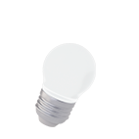
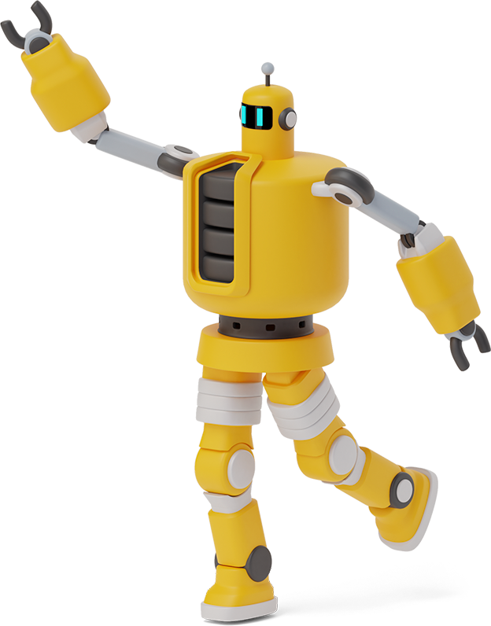
Smart Aquarium Based on iot

Slide 2

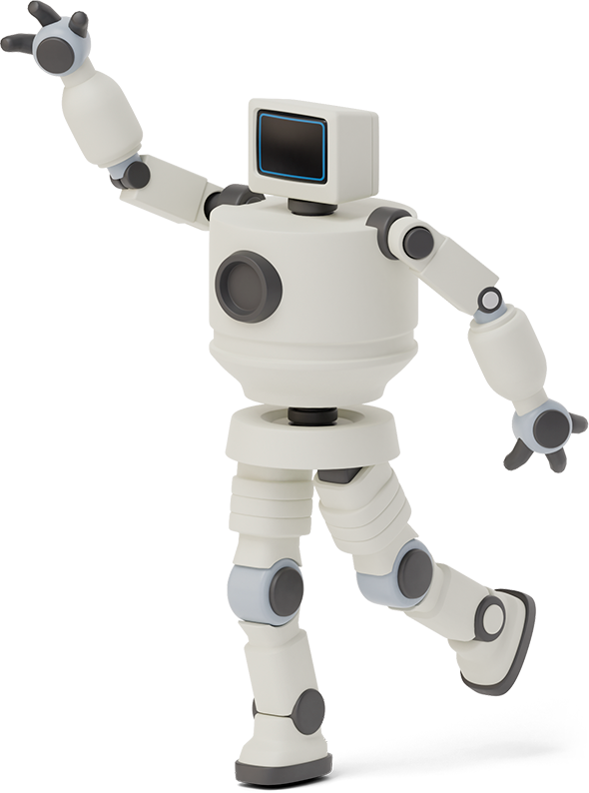

Hello!
Sri VAIKUNTH
SHREYANSH
SAI PAVAN TEJA
we are here because we love to give presentations.

Slide 3

Abstract
In this Project, we will make the aquarium that is
fully automated and can be monitored remotely.
Major features of this project are the mechanical feed design, and remote monitoring of parameters like feed level, water level.
This task is achieved using IBM IOT Watson platform, Node Red, MIT app inventor and Fast2sms.
This is supposed to reduce human efforts and errors in owing an aquarium.

Slide 4
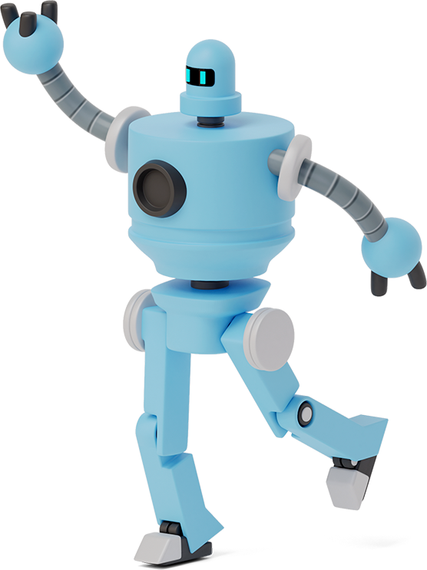
“The Internet Of Things has potential to channge the world, just as the Internet did. Maybe
even more so”.

Slide 5
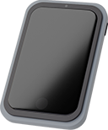
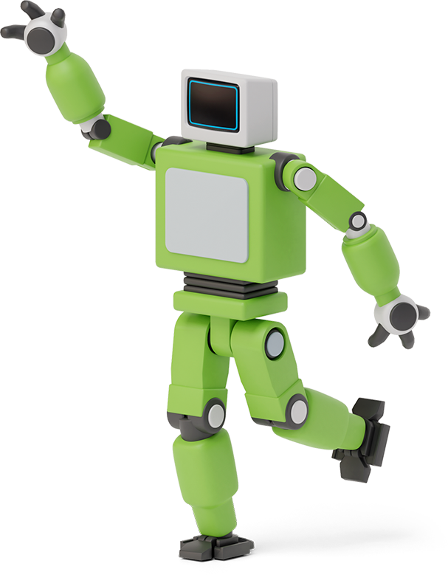

LIST Of ITEMS TO DISCUSS
BIG CONCEPT
ROADMAP
SENDIND DATA TO CLOUD
NODE RED FLOW
WEB UI
MIT MOBILE APPLICATON
OUTPUT

Slide 6
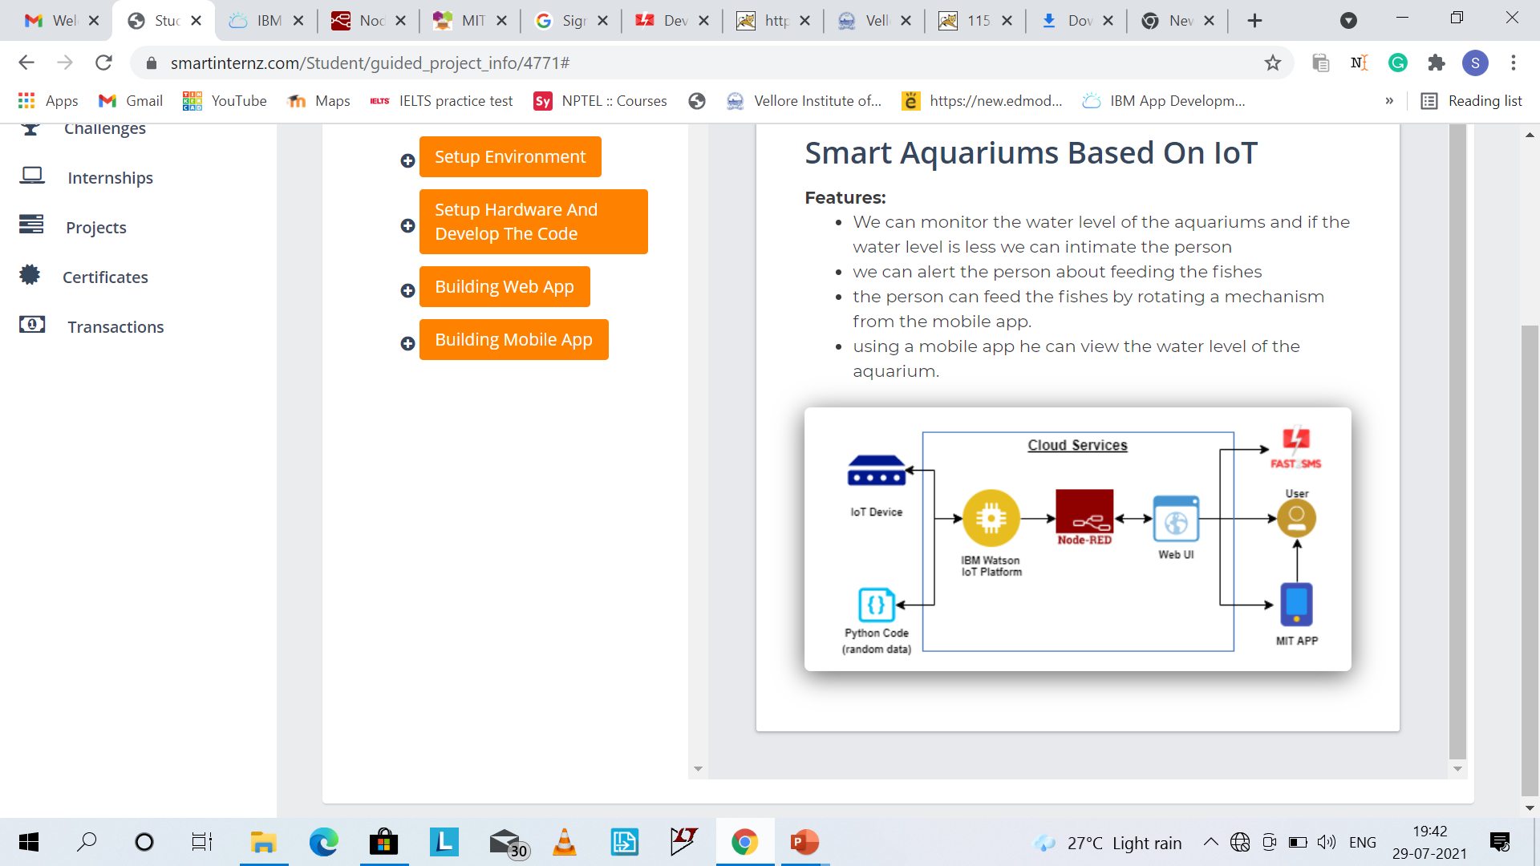

Big concept

Slide 7
Roadmap
INSTALL REQUIRED PYTHON MODULES/PACKAGES TO INTEGERTAE PYTHON WITH IBM CLOUD
CONFIGURE THE NODE RED FLOW TO RECEIVE DATA FROM IBM IOT PLATFORM
BUILD A MOBILE APLLICATION TO DISPLAY THE SENSOR VALUES
1
3
5
2
4
6
DEVELOP THE PYTHON CODE TO SEND RANDOM WATER LEVEL SENSOR DATA TO THE CLOUD
CREATE HTTP API’S FOR SENDING AND RECEIVING DATA FROM MOBILE APPLICATION
CONFIGURE THE APLLICATION TO REECIVE THE DATA FROM CLOUD

Slide 8
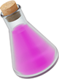


Sending data to ibm cloud

Slide 9
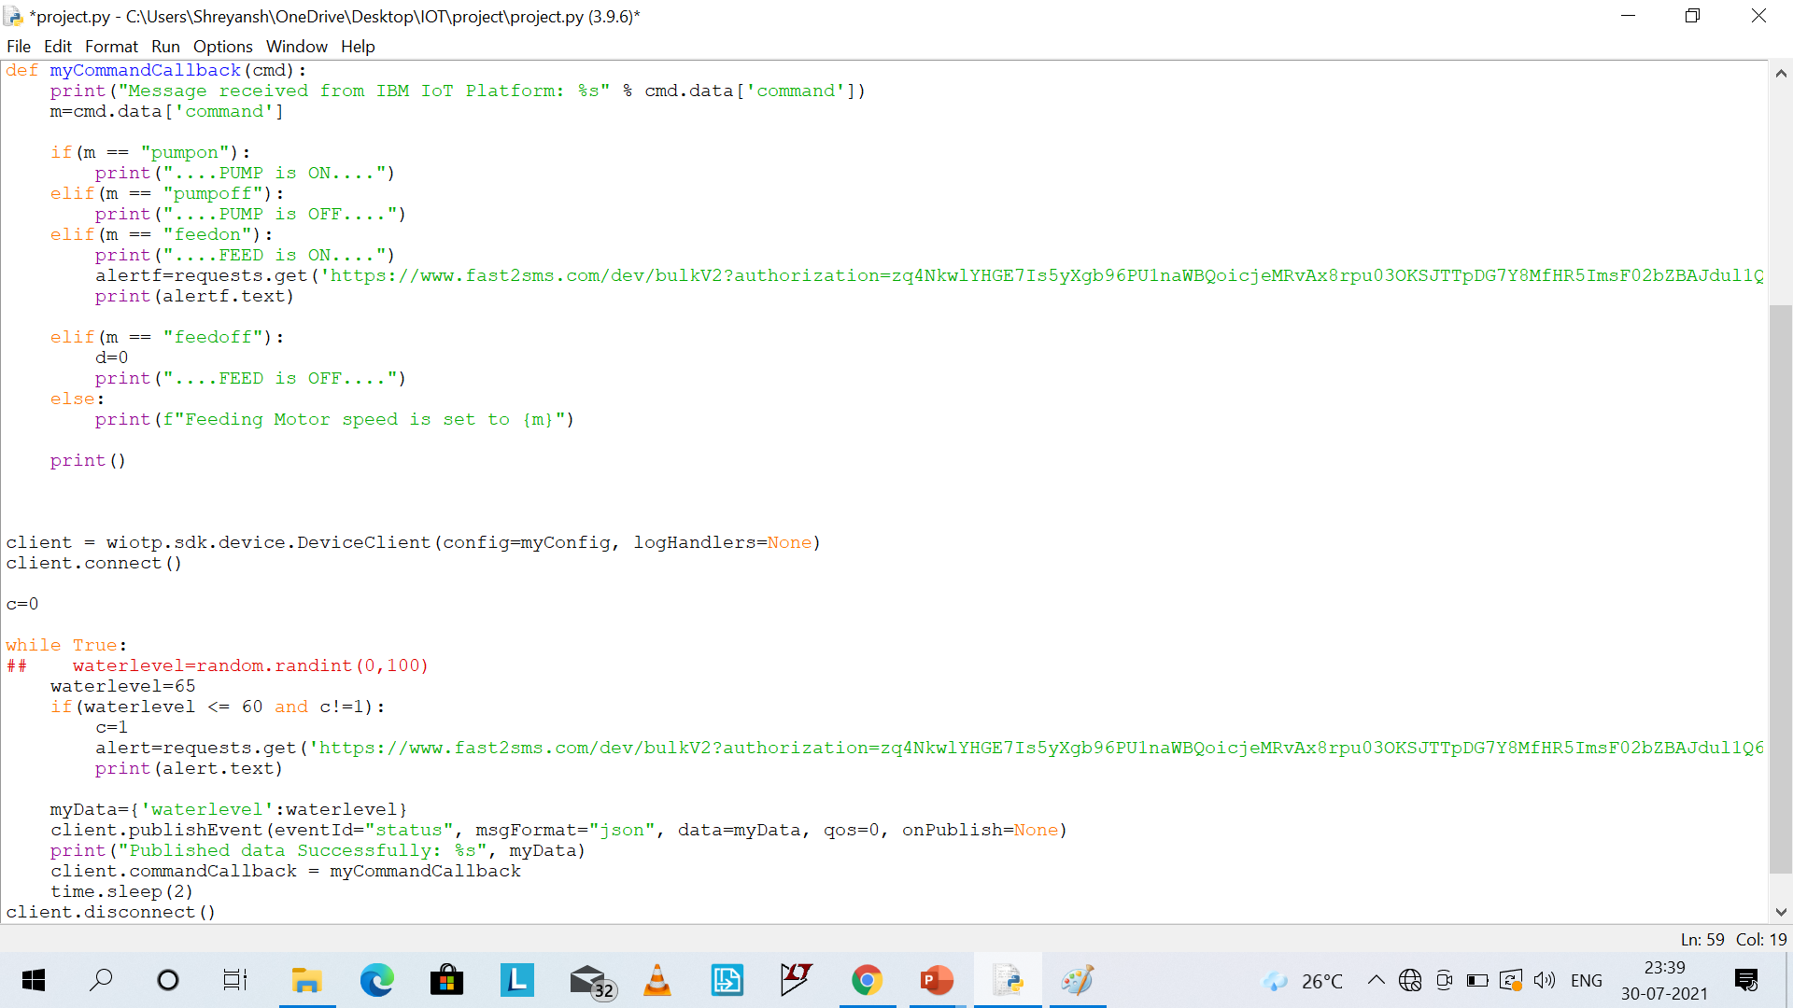
PYTHON CODE

Slide 10
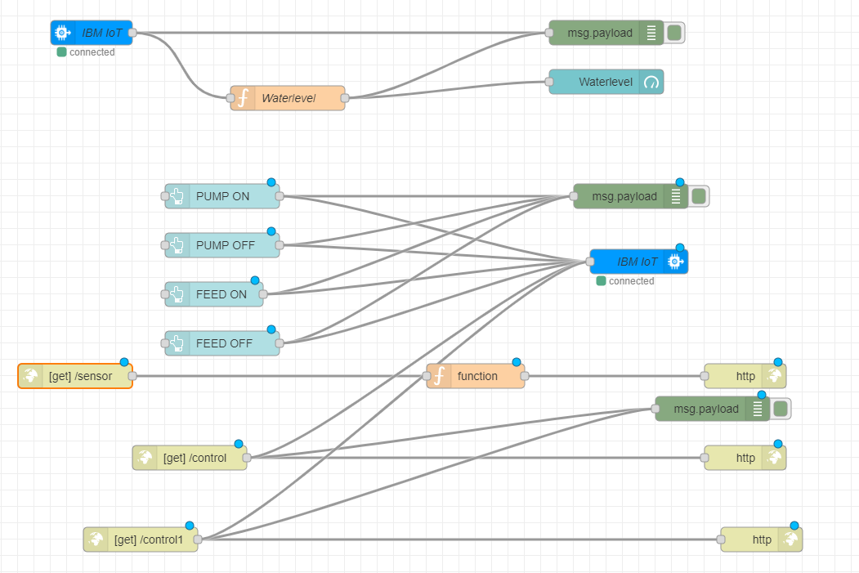
Node red flow

Slide 11
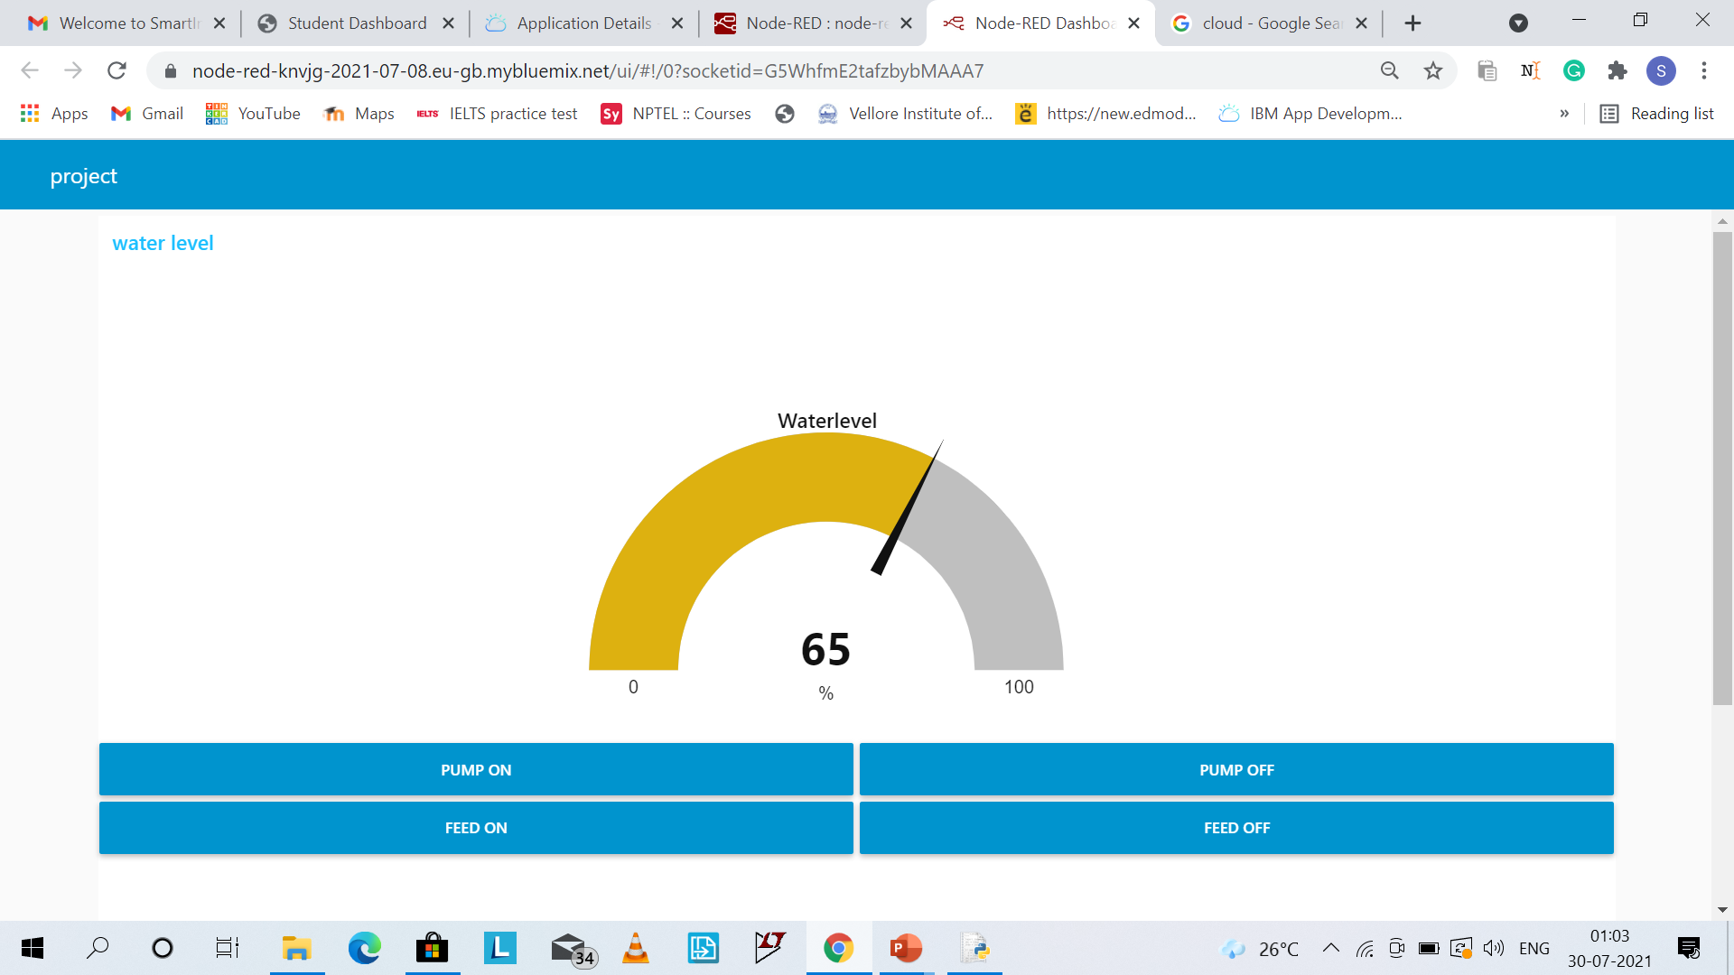
Web ui

Slide 12
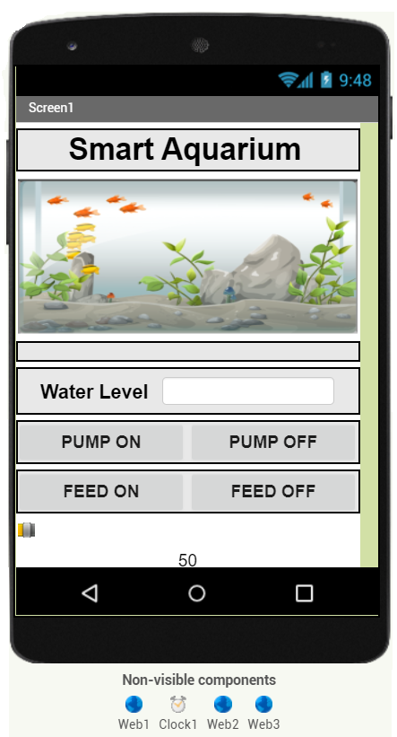

building mobile application
It displays the sensor values and the buttons to control the water pump and feeding mechanism.

Slide 13
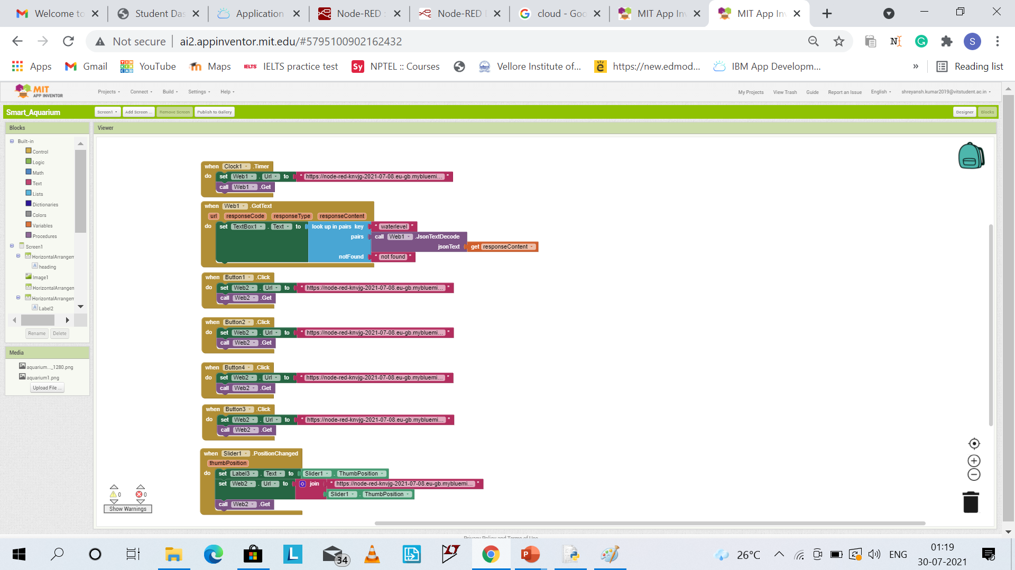
Blocks at back

Slide 14
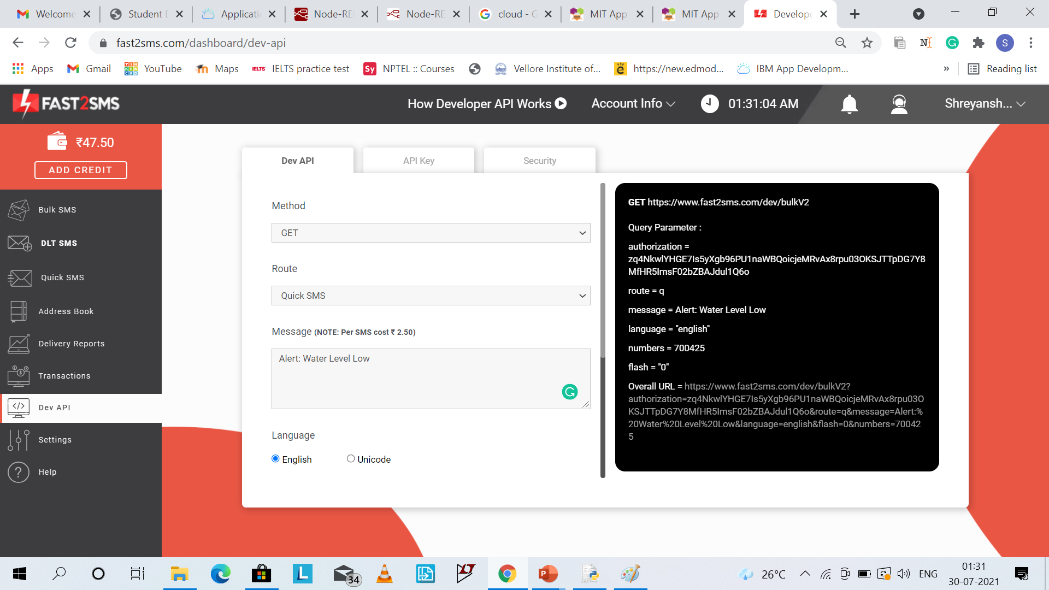
intimating the user
It will send a message “Alert: Water Level Low” to the user when water level goes below a certain value.

Slide 15
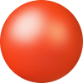
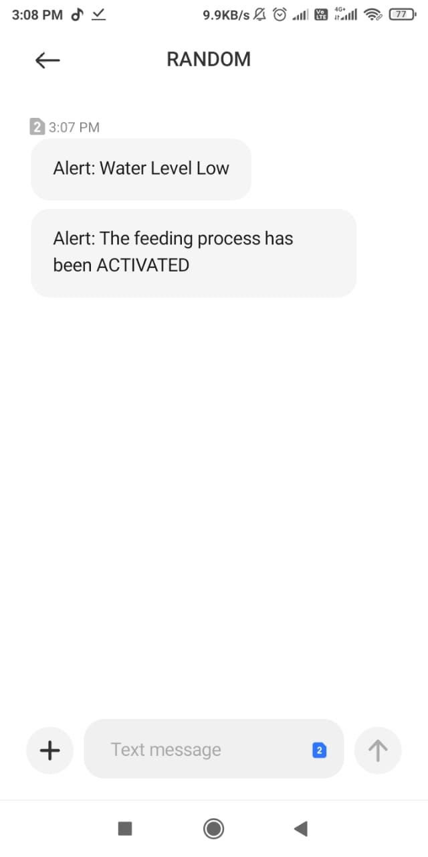
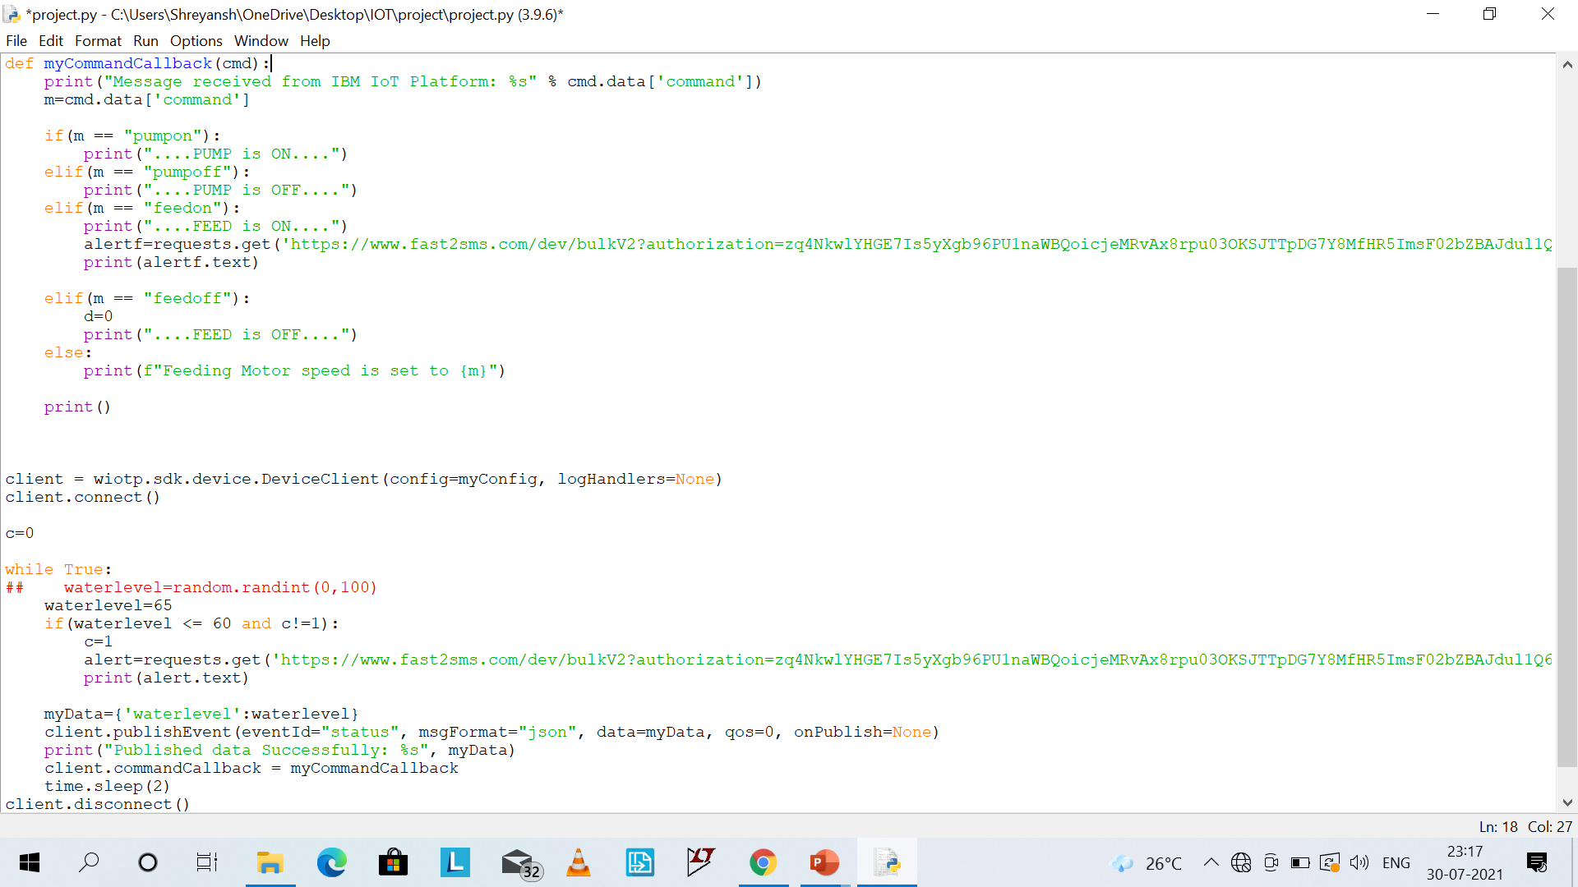
When water level is set to 65 and button feed on is pressed
LOWER THRESHOLD WATER LEVEL IS SET TO 60

Slide 16

When water level is set to 55 and button feed on is pressed
LOWER THRESHOLD WATER LEVEL IS SET TO 60

Slide 17
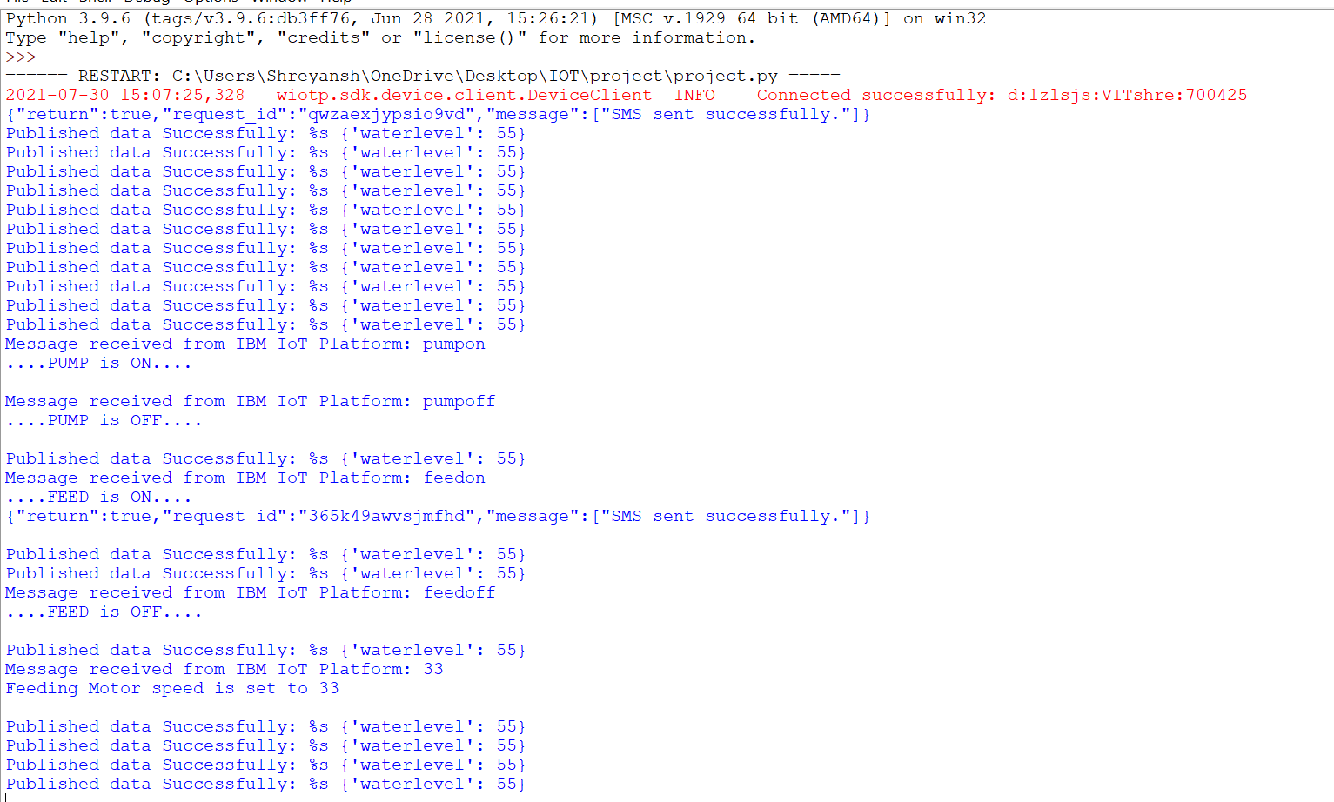
Output in python shell

Slide 18
THANK YOU

